Slide 1
CS23403 – FULL STACK TECHNOLOGIES
UNIT 1 – OVERVIEW OF FULL STACK
B.E. COMPUTER SCIENCE AND ENGINEERING
2023 REGULATION

Slide 2
Full Stack Technologies - Introduction
Full Stack Development refers to - design, development - deployment of a complete web application
Covers client-side (front-end) and server-side (back-end) components
Includes databases, web services, APIs and deployment mechanisms.

Slide 3
The Web Application Architecture
The presentation layer (what the user sees),
The application logic layer (how the system behaves),
The data layer (how data is stored and retrieved),
The communication layer (APIs, middleware),
The deployment and security layer.

Slide 4
Syllabus Coverage
Application Layer | Units Covered | Technologies Involved
Presentation Layer | UNIT I, UNIT III | (Browser, HTML, CSS, JavaScript, Angular, React, TypeScript, JSX)
Application Logic Layer | UNIT II, UNIT IV | (Node.js, Express.js, Event-driven programming, Callbacks, Controllers, Business Logic)
Data Layer | UNIT IV | (MongoDB, NoSQL, Collections, Documents, CRUD Operations)
Communication Layer | UNIT I, UNIT II, UNIT V | (HTTP/HTTPS, REST APIs, JSON, XML, Middleware, Request–Response Model, Microservices)
Deployment & Security Layer | UNIT V | (Application Deployment, Web Servers, Cloud Platforms, TLS/SSL Certificates, Secure APIs)

Slide 5
Basic Web Development Framework - Introduction
How a Web Browser Works?

Slide 6
Basic Web Development Framework - Introduction
The Basic Web Development Framework explains
How the web application is created, executed, and delivered to the user through a client–server architecture.
It defines the interaction between the browser, front-end technologies, back-end services and data exchange mechanisms.

Slide 7
Basic Web Development Framework - Introduction
Request: You type a URL (web address) or click a link, and the browser sends a request to a web server.
Fetch: The server sends back files (HTML, CSS, images, Java Scripts).
Render: The browser's rendering engine interprets these files and displays them as a readable webpage on your device.
Interprets HTML for structure,
Applies CSS for styling,
Executes JavaScript for logic and interaction.

Slide 8
Hyper Text Markup Language (HTML)
HTML is a markup language
A markup language
Uses Tags (markups) to define, describe the structure content so that a computer program (like a browser) displays the contents
HTML is case-insensitive
Tags usually come in pairs
HTML describes structure, not behaviour
Works together with CSS and JavaScript

Slide 9
Hyper Text Markup Language (HTML)
Why HTML is Important?

Slide 10
Hyper Text Markup Language (HTML)
Every website starts with HTML
It is the foundation of web development
Browsers understand HTML directly
Used with CSS and JavaScript to build complete websites

Slide 11
HTML –Basic Structure
<html> - Root Element
<head> - Meta Information
<title>My First Page</title> - Page Title
</head>
<body> - Visible Content
<h1>Hello World</h1>
<p>This is my first HTML page.</p>
</body>
</html

Slide 12
HTML – Text Formatting Tags
Tag | Purpose
<h1> to <h6> | Headings (h1 is largest)
<p> | Paragraph
<br> | Line break
<hr> | Horizontal line
<strong> | Important text (bold)
<em> | Emphasized text (italic)

Slide 13
HTML – Links and Image Tags
Tag | Purpose
<a> | Creates a hyperlink
<img> | Displays an image
<a href="https://www.google.com">Visit Google</a>
<img src="image.jpg" alt="My Image">

Slide 14
HTML - List Tags
Tag | Purpose
<ul> | Unordered list (bullets)
<ol> | Ordered list (numbers)
<li> | List item

Slide 15
HTML – Table Tags
Tag | Purpose
<table> | Creates a table
<tr> | Table row
<th> | Table heading
<td> | Table data
<table border="1">
<tr>
<th>Name</th>
<th>Age</th>
</tr>
<tr>
<td>Anu</td>
<td>20</td>
</tr>
</table>

Slide 16
HTML – Form tags
Tag | Purpose
<form> | Collects user input
<input> | Input field
<label> | Label for input
<textarea> | Multi-line input
<button> | Clickable button
<select> | Dropdown list

Slide 17
HTML Attributes
Attributes give extra information to tags.
Common Attributes:
class → Used for styling
src → Source of image
href → Link URL
alt → Alternate text for image
HTML COMMENT
<!-- This is a comment -->

Slide 18
Cascading Style Sheets - Introduction
CSS (Cascading Style Sheets) is used to style and design HTML web pages.
Controls how HTML elements look
Defines colours, fonts, spacing, layout
Separates content (HTML) from design (CSS)
Makes webpages attractive and allows reusability

Slide 19
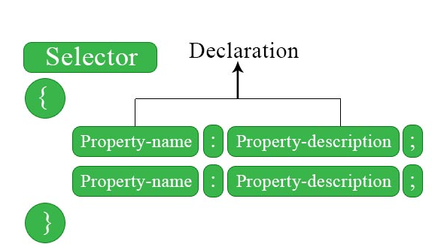
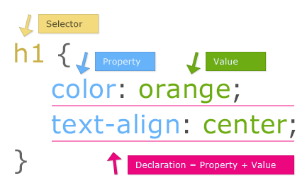
Declaration : Selector and Rules of CSS

Slide 20
Ways to apply CSS
1) Inline CSS
Applied directly inside HTML tags
<p style="color:red;">Hello</p>

Slide 21
Ways to apply CSS
2) Internal CSS
Written inside <style> tag in <head>
<style>
h1 { color: green; }
</style>

Slide 22
Ways to apply CSS
3) External CSS
Written in a separate .css file.
<link rel="stylesheet" href="style.css"> - link tag is used to establish an external connection

Slide 23
CSS Selectors
Selector | Example | Purpose
Element | p | All paragraphs
Class | .box | Elements with class
ID | #main | Unique elements of the page
Group | h1, p | Multiple elements
#main {
background-color: lightblue;
}

Slide 24
CSS – Text and Font & Background
color
font-size
font-family
text-align
background-color
background-image

Slide 25
CSS Box Model
Every HTML element is treated as a box.
Content – actual text/image
Padding – space inside border
Border – outline
Margin – space outside element
div {
margin: 10px;
padding: 20px;
border: 1px solid black;
}

Slide 26
Class in HTML
<!-- Single class -->
<p class="intro">This is an introductory paragraph.</p>
<!-- Multiple elements with the same class -->
<div class="card">
<h2>Card Title</h2>
<p>Card content.</p>
</div>
<div class="card">
<h2>Another Card Title</h2>
<p>More card content.</p>
</div>
<!-- Element with multiple classes -->
<button class="button button-primary">Click Me</button>

Slide 27
Class in CSS – Same style to various HTML elements
/* Select all elements with the class 'intro' */
.intro {
color: blue;
font-size: 1.2em;
}
/* Select all elements with the class 'card' */
.card {
border: 1px solid #ccc;
padding: 15px;
margin-bottom: 10px;
}
/* Define base styles for all 'button' classes */
.button {
padding: 10px 15px;
cursor: pointer;
}

Slide 28
CSS Practices to follow
Use external CSS
Avoid inline styles
Use meaningful class names
Keep CSS reusable
Follow consistent formatting

Slide 29
Javascript - Introduction
JavaScript is a client-side scripting language
Used to make web pages interactive and dynamic.
Runs in the browser
Makes pages interactive (clicks, alerts, validation)
Works with HTML and CSS
Used in frontend and backend (Node.js)
Frontend behavior (buttons, forms)

Slide 30
Javascript Example
<script>
alert("Welcome to Full Stack Development");
</script>
Basically:
HTML → Structure
CSS → Style
JavaScript → Behavior

Slide 31
Javascript - Introduction
Where do I write my Javascript?

Slide 32
Javascript - Introduction
Way 1: Inside the <script> tag in an HTML file.
<!DOCTYPE html>
<html>
<head>
<title>JS Inside HTML</title>
</head>
<body>
<h2>Hello Students</h2>
<script>
alert("JavaScript is working!");
</script>
</body>
</html>

Slide 33
Javascript - Introduction
Way 2: JavaScript in External File (.js file) & Way3 – Inline is not recommended
Step 1 : Create a file name script.js
Step 2 : In script.js,
function greet() {
alert("Welcome to Full Stack");
}
Step 3: Link script.js with html
<script src="script.js"></script>

Slide 34
Javascript - Introduction
<!DOCTYPE html>
<html>
<head>
<title>External JS</title>
</head>
<body>
<button onclick="greet()">Click Me</button>
<script src="script.js"></script>
</body>
</html>

Slide 35
Javascript – Functions:
A function is a block of reusable code that performs a specific task.
We use functions to:
Avoid repetition
Improves readability
Easier maintenance

Slide 36
Javascript - Functions
Syntax:
function functionName() {
// code
}
function greet() {
console.log("Hello Students");
}
greet(); // function call

Slide 37
Javascript - Functions
With Paramaters:
function add(a, b) {
return a + b;
}
let result = add(10, 20);
console.log(result);

Slide 38
Javascript - Arrays
An array is a collection of multiple values stored in a single variable.
Type Name | Purpose | Example
Single-Dimensional Array | Stores multiple values in a single list | let colors = ["Red", "Green", "Blue"];
Multi-Dimensional Array | Stores data in rows and columns using nested arrays | let marks = [[85, 90], [78, 88]];
Homogeneous Array | Stores elements of the same data type | let numbers = [10, 20, 30, 40];
Heterogeneous Array | Stores elements of different data types | let student = ["Ravi", 21, true];
Array of Objects | Stores multiple objects in a single array | let students = [{name:"Anu", age:20}, {name:“Ram", age:22}];

Slide 39
Javascript - Array
Example
let subjects = ["HTML", "CSS", "JavaScript"];
console.log(subjects);
Accessing the array:
console.log(subjects[0]); // HTML
console.log(subjects[1]); // CSS

Slide 40
Javascript - Array
Common array operations:
subjects.push("React"); // add element
subjects.pop(); // remove last element

Slide 41
Javascript -Objects
An object stores data in key–value pairs.
let student = {
name: "Anu",
age: 20,
course: "Full Stack"
};
console.log(student.name);
console.log(student.course);

Slide 42
Javascript - String
A string is a sequence of characters used to represent text.
Syntax:
let message = "Welcome to JavaScript";
console.log(message);

Slide 43
Common String Operations
console.log(message.length);
console.log(message.toUpperCase());
console.log(message.toLowerCase());

Slide 44
Javascript – String - Example
let firstName = "Ravi";
let lastName = "Kumar";
let fullName = firstName + " " + lastName;
console.log(fullName);

Slide 45
Javascript – Overview & Purpose
Concept | Purpose
JavaScript | Adds interactivity
Function | Reusable code
Array | Stores multiple values
Object | Stores key–value data
String | Stores text

Slide 46
XML –Extensible Markup Language
What is markup?
XML (eXtensible Markup Language) is a markup language used to store, structure and transport data between different systems in a platform-independent manner
What makes it extensible?
XML is not used for web designing because it is used to store and transport data, not to display or style web pages.

Slide 47
Why XML?
Different systems/ different programming languages/ different platforms – xml is common data format
These issues are solved by XML using:
A common data format
Platform-independent communication
Structured and self-descriptive data

Slide 48
XML –Extensible Markup Language
Extensible - We can create our own tags
Markup Language - Uses tags to mark or describe data
<student>
<name>Anu</name>
</student>
Here, <student> and <name> are user-defined tags.

Slide 49
XML –Extensible Markup Language
Structured data storage format
<employee>
<id>101</id>
<name>Ravi</name>
</employee>
Stores in a tree like hierarchical structure
Platform Independent

Slide 50
XML – Transporting data between different systems
XML is commonly used to transfer data between:
Client - Server
Application - Application
Web services - Databases

Slide 51
XML Core components
Elements: Data enclosed by start and end tags (e.g., <name>John</name>).
Attributes: Provide additional info about elements (e.g., <book id="123">).
XML Declaration: <?xml version="1.0" encoding="UTF-8"?> provides metadata about the document.

Slide 52
XML Core components
Component | Purpose
XML Declaration | Defines version and encoding
Elements | Store data
Root Element | Parent of all elements
Attributes | Additional element info
Namespaces | Avoid name conflicts
Comments | Human explanation
DTD / XSD | Validation

Slide 53
The rules/ properties that makeup XML
XML must have one root element
Tags must be properly nested
Tags are case-sensitive and strict syntax rules
Closing tags are mandatory
Attribute values must be in quotes
<student id="101">
<name>Anu</name>
</student>

Slide 54
Can we design websites using HTML?

Slide 55
Then where do we use XML?
Layer | Role
Frontend | HTML, CSS, JavaScript
Backend | Java, Node.js, Python
Data Exchange | XML
Database | MySQL, MongoDB

Slide 56
Data Transport in XML
Data transport in XML refers to the process of sending data from one system to another using XML format.
XML acts as a carrier (medium) for data between applications.
Different systems may use: Different operating systems/Different programming languages / Different databases

Slide 57
XML Validation - “If XML allows user-defined tags, why validation and syntax rules?”
XML validation is the process of verifying whether an XML document follows the defined structure and rules
Validation ensures:
Correct structure
Correct data format
Error-free data exchange

Slide 58
XML Validation
XML can be validated in two stages:
Stage 1: Well Formed XML
<student>
<name>Arun</name>
</student>
---------------
<student>
<name>Arun</student>

Slide 59
XML Validation
Stage 2:
Type 1: DTD (Document Type Definition) – Basic Structure rules
student.dtd
<!ELEMENT student (name, marks)>
<!ELEMENT name (#PCDATA)>
<!ELEMENT marks (#PCDATA)>
<!DOCTYPE student SYSTEM "student.dtd">
<student>
<name>Arun</name>
<marks>85</marks>
</student>

Slide 60
XML Validation
Stage 2: Type 2
Follows a DTD or XML Schema (XSD)
<xs:element name="marks" type="xs:integer"/>
Validation flow diagram:

Slide 61
Validation Flow
XML Document
Syntax Check (Well-Formed)
DTD / XSD Validation
Safe Data Processing

Slide 62
Applications of XML
No. | Application | Description | Example
1 | Data Exchange Between Systems | XML allows structured data to be shared between different platforms and programming languages. | Bank transaction data sent between client and server
2 | Web Services | XML is the core format for SOAP messages and service communication in web services. | SOAP API for online payment gateway
3 | Configuration Files | XML stores application settings and configurations in a readable and structured format. | web.xml in Java web applications, Spring configuration files
4 | Document Representation | XML is used to structure and store documents in a platform-independent way. | Office documents (DOCX), RSS feeds, technical manuals

Slide 63
Difference between XML and HTML
XML | HTML
Used to store and transport data | Used to display data
Focuses on data meaning | Focuses on data presentation
User-defined tags | Predefined tags
Strict syntax rules | Flexible syntax rules
Case-sensitive | Not case-sensitive
Data-oriented language | Presentation-oriented language
Used in data exchange and web services | Used to create web pages
HTML - “What you see”
CSS - “How it looks”
JavaScript - “How it behaves”
XML - “What data is exchanged”

Slide 64
Externally linking XML to JS
<script>
// Load XML using JS
let xhr = new XMLHttpRequest();
xhr.open("GET", "students.xml", false); // synchronous
xhr.send();
let xmlDoc = xhr.responseXML;
let students = xmlDoc.getElementsByTagName("student");
let ul = document.getElementById("studentList");
for (let i = 0; i < students.length; i++) {
let li = document.createElement("li");
li.textContent = students[i].getElementsByTagName("name")[0].childNodes[0].nodeValue;
ul.appendChild(li);
}
</script>

Slide 65
Embedding XML to JS
<script>
let xmlData = document.getElementById("xmlData").textContent;
let parser = new DOMParser();
let xmlDoc = parser.parseFromString(xmlData, "text/xml");
let students = xmlDoc.getElementsByTagName("student");
let ul = document.getElementById("studentList");
for (let i = 0; i < students.length; i++) {
let li = document.createElement("li");
li.textContent = students[i].getElementsByTagName("name")[0].childNodes[0].nodeValue;
ul.appendChild(li);
}
</script>

Slide 66
Why we need XML when there is JS already?
JS Only | XML + JS
Data and logic are together in JS. | Data is separate from logic.
Harder to update for non-programmers. | Anyone can update XML without touching code.
If JS file changes, data changes must be coded manually. | Data changes in XML don’t affect JS code.

Slide 67
Class Activity
Create a web page that lists upcoming college events stored in an XML file. Display events using JavaScript and style the page with CSS.

Slide 68
XML file
<?xml version="1.0" encoding="UTF-8"?>
<events>
<event>
<name>College Orientation</name>
<date>2026-01-10</date>
</event>
<event>
<name>Science Fest</name>
<date>2026-02-05</date>
</event>
<event>
<name>Sports Day</name>
<date>2026-03-15</date>
</event>
</events>

Slide 69
HTML file
<!DOCTYPE html>
<html>
<head>
<title>College Events</title>
<link rel="stylesheet" href="style.css">
</head>
<body>
<h1>Upcoming College Events</h1>
<ul id="eventList"></ul>
<script src="script.js"></script>
</body>
</html>

Slide 70
CSS file
body {
font-family: Arial, sans-serif;
text-align: center;
margin-top: 30px;
}
h1 {
color: #FF6347;
}
li {
color: #2E8B57;
font-size: 18px;
margin: 5px 0;
}

Slide 71
JS File
let xhr = new XMLHttpRequest();
xhr.open("GET", "events.xml", false);
xhr.send();
let xmlDoc = xhr.responseXML;
let events = xmlDoc.getElementsByTagName("event");
let ul = document.getElementById("eventList");
for (let i = 0; i < events.length; i++) {
let name = events[i].getElementsByTagName("name")[0].childNodes[0].nodeValue;
let date = events[i].getElementsByTagName("date")[0].childNodes[0].nodeValue;
let li = document.createElement("li");
li.textContent = `${name} - ${date}`;
ul.appendChild(li);
}

Slide 72
JSON – JavaScript Object Notation
Lightweight text based standardized data interchange format
Used for storing and exchanging data between client and server
Derived from JavaScript Object Syntax
Represents data as Key (always string) – Value pairs (can be string, arrays, objects, numbers, boolean)
Lightweight when compared to XML
{ "name": "Arun" } Vs <name>Arun</name>
JSON is the default data format for RESTful APIs (lightweight and compact & easy to parse and generate due to direct mapping of JavaScript Object)

Slide 73
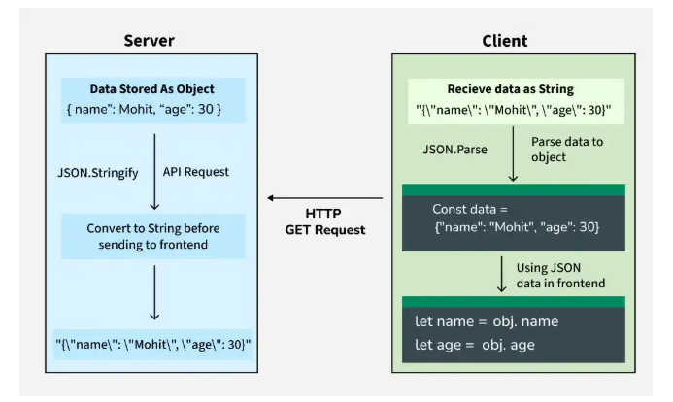
Data Flow from Server to Client
const jsonString = '{"name":"Mohit", "age":30}’;
This string is received from Server.
const jsonS = '{"name":"Mohit", "age":30}'; const obj = JSON.parse(jsonS); let name = obj.name; let age = obj.age; console.log(`Name: ${name}, Age: ${age}`);
This is to access the string’s properties – parsing into JS objects
Name: Mohit, Age: 30
This is the text displayed in respective fields of the UI

Slide 74
Example
User interacts with web application to make purchase
Application sends the user’s input to the server in JSOn format
Server processes the data
Sends back a response in JSON format
Then the data is rendered by the web application
This allows for data exchange between client and server – enhances fast - dynamic – interactive web experience

Slide 75
JSON Sample Code – Basic JSON Objects, Nested Objects and Arrays
{"menu":
{
"id": "file",
"value": "File",
"popup":
{
"menuitem": [
{"value": "New", "onclick": "CreateNewDoc()"},
{"value": "Open", "onclick": "OpenDoc()"},
{"value": "Close", "onclick": "CloseDoc()"}
]
}
} }

Slide 76
Why JSON?
Language independent (JavaScript, Java, Python, C#, Go, Ruby)
Ideal format for exchanging data across different programming languages and platforms (web applications, mobile applications, cloud platforms, IoT systems)
Eg: Application written in JAVA can send JSON data to a python application
Mobile Application written in JS can use JSON to communicate with back end server written in PHP
Reason being, both systems can parse and generate in JSON

Slide 77
JSON Vs HTML Vs XML
There are predominantly two formats for storing and transmitting data on the web - JSON and XML
JSON – Data storage and transfer - Used in applications that use simple, easy to use data format
XML – General purpose markup language – Similar to JSON – more complex data structure
HTML – Designing the structure of web pages – Used along with CSS and Javascript

Slide 78
Web Server
The computer that supplies files or service to the requesting computer over internet is called web server
Request to the web page is sent by the browser to the server
The server will transfer the requested page to the computer over the internet
Example: When you open Google, the Google web server sends the Google web page to your browser.

Slide 79
Working of a Web Server
The URL is broken into 3 parts
The protocol – HTTP/ HTTPS
The server name – www. abc.com
The file name ( “web – server.html”)
The user types a website name like www.google.com.
The browser contacts a DNS (Name Server).
The DNS server converts the website name into an IP address.
The browser uses this IP address to contact the web server.
The web server sends the web page back to the browser.

Slide 80
Backend Services
Backend services refer to server-side components of a web application
This handles business logic, data processing, authentication and communication with databases - to provide responses to client requests through APIs.
Backend services act as an intermediary between the frontend and the database.
A student management system where the backend handles requests to fetch or update student data, validates the input, interacts with a MongoDB database, checks user permissions and sends responses in JSON format.
Browser → Frontend → Backend Services → Database → Response in JSON

Slide 81
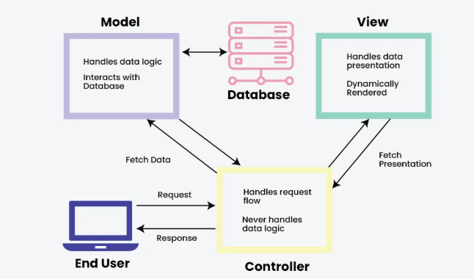
MVC – Model Control View Architecture

Slide 82
MVC Architecture
MVC (Model–View–Controller) is a design pattern used in software and web development to separate concerns in an application.
Model – for the logic
Represents the data and business logic.
Interacts with the database to fetch or update data.
Example: In a student management system, the Model contains student details and logic to calculate grades.

Slide 83
MVC Architecture
View – for Display
Represents the user interface.
Displays data to the user and collects input.
Example: HTML/CSS pages showing student details.

Slide 84
MVC Architecture
Control – to validate and update the view
Acts as a bridge between Model and View.
Handles user input, processes requests, updates model and refresh the page view
Example: When a user submits a form, the Controller validates the input and updates the database through the Model and refresh the display view

Slide 85
Flow of MVC
User → View → Controller → Model → Controller → View → User
User interacts with the View (UI) – example of a web application where students enter their marks and calculate CGPA.
View displays the updated data to the user – what the student sees and interact with
Controller receives input, applies logic and updates Model - Receives input from View, sends data to Model, and updates View
Model changes data and notifies Controller/View – stores student marks and calculate CGPA

Slide 86
MEAN and MERN Stacks
A technology stack is a combination of
Frontend
Backend
Database technologies, used to build a complete web application.
MEAN stack is a full-stack JavaScript framework consisting of MongoDB, Express.js, Angular, and Node.js.
Used to design Single Page Applications (eliminates full page reloads – browser sends API calls, server sends data in JSON format)

Slide 87
MEAN and MERN Stacks
MongoDB – NoSQL(Not Only SQL)- document-oriented database – stores data in JSON format.
Express.js - backend web framework built on top of Node.js - handle server-side logic and routing – HTTP request and response – Used to create RESTful API’s.
Angular – client side - frontend framework - based on the MVC architecture –
Node.js is a server-side JavaScript runtime environment that executes JavaScript outside the browser.
The MEAN stack uses JavaScript across all layers, making development faster and consistent.

Slide 88
MEAN and MERN Stacks
MERN stack is similar to MEAN but replaces Angular with React.
React - JavaScript library developed by Meta (interactive user interfaces)
React handles the View layer and is not a full MVC framework – uses component, VDOM (Virtual Document Object Memory)
MERN stack - used for applications requiring high frontend interactivity.
Both MEAN and MERN stacks are suitable for building Single Page Applications (SPAs).
Difference between SPA and VDOM?
SPA decides when the page reloads, Virtual DOM decides how the page updates.

Slide 89
API’s
An API is a set of rules that allows one software application to communicate with another.
API allows the frontend (browser / mobile app) to communicate with the backend server.
How an API Works?
The client sends a request to the server using an API
The server processes the request
The server sends a response, usually in JSON format
Many applications uses RESTful API’s (HTTP protocol, Stateless communication, Data exchange in JSON format)

Slide 90
API’s
HTTP methods used in API’s: (similar to CRUD in SQL)
GET – Retrieve data – fetch student data
POST – Send new data – Calculate CGPA
PUT – Update existing data – Update marks
DELETE – Remove data – Remove student record
API’s allows multiple clients(mobile and web) to use same backend

Slide 91
Middleware
Middleware is software that sits between the request and the response in a web application.
Middleware is used for logging, authentication, validation, JSON data parsing, error handling
Types of middleware:
Application level – route level – built in (used in express – error handling middleware)

Slide 92
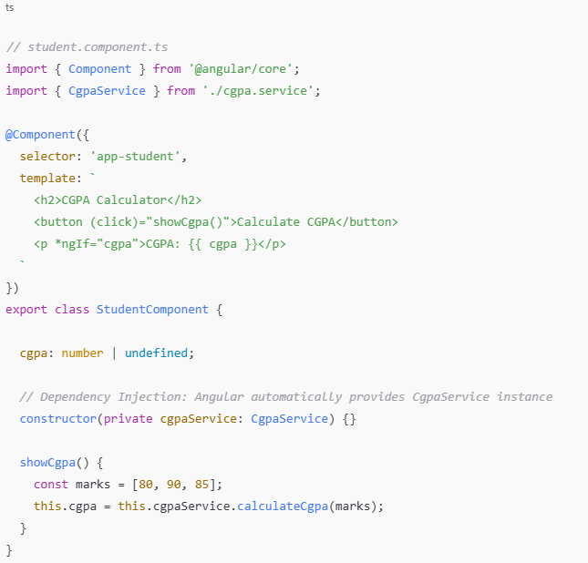
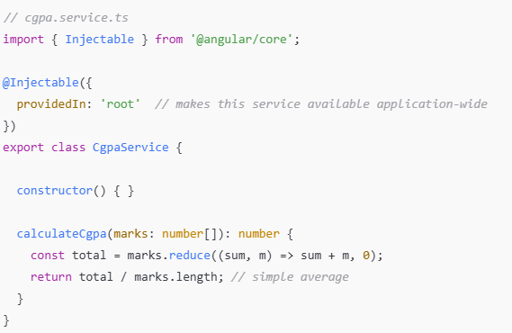
Example for Dependency Injection

